Slide 1
Python Operations
Session-03

Slide 2
Python divides the operators in the following groups:
Arithmetic operators
Assignment operators
Comparison operators
Logical operators
Identity operators
Membership operators
Bitwise operators
In this section we will only look at examples of arithmetic operations. We will cover the other operations when we cover the topic of conditionals

Slide 3
Arithmetic Operators
Python allows us to do all sort of arithmetic operations on numbers. You can do operations on numbers directly, example:
a = 5+4
or, operations on variables containing numbers
a = 5
b = 6
c = a+b

Slide 4
Addition of 2 numbers
You can add 2 numbers by using a '+' sign between the 2 numbers that you want to add.
add = num1 + num2
Example
a=100
b=3
add = a + b
print(add)

Slide 5
Subtraction of 2 numbers
You can subtract 2 numbers by using a '-' sign between the 2 numbers that you want to subtract.
sub = num1 - num2
Example:
sub = a-b
print(sub)

Slide 6
Multiplication of 2 numbers
You can multiply 2 numbers by using a '*' sign between the 2 numbers that you want to multiply.
mul = num1 * num2
Example
mul = a*b
print(mul)

Slide 7
Division of 2 numbers
You can divide 2 numbers by using a '/' sign between the 2 numbers that you want to divide.
div = num1 / num2
Example :
div= a/b
print(div)

Slide 8
Modulus of 2 numbers
Modulus is the remainder you get when you divide 2 numbers.
You can find the modulus of 2 numbers by using a '%' sign between the 2 numbers.
mod = num1 % num2
Example :
mod = a%b
print(mod)

Slide 9
Floor division of 2 numbers
Floor division gives us the quotient of the division between 2 numbers. You can floor divide 2 numbers by using a '//' sign between the 2 numbers.
quotient = num1//num2
Example :
quotient= a//b
print(quotient)

Slide 10
Exponentiation of 2 numbers
You can do x raised to the power y in python by using a '**' sign between the 2 numbers.
exp = num1 ** num2
Example :
exp= a**b
print(exp)
Note
When you have multiple operations, python operates using the standard PODMAS / BODMAS rule

Slide 11
Python Assignment Operators
Assignment operators are used to assign values to variables:
Operator Example Same As
= x = 5 x = 5
+= x += 3 x = x + 3
-= x -= 3 x = x - 3
*= x *= 3 x = x * 3
/= x /= 3 x = x / 3
%= x %= 3 x = x % 3
//= x //= 3 x = x // 3
**= x **= 3 x = x ** 3
&= x &= 3 x = x & 3
|= x |= 3 x = x | 3
^= x ^= 3 x = x ^ 3
>>= x >>= 3 x = x >> 3
<<= x <<= 3 x = x << 3

Slide 12
1) Assign: This operator is used to assign the value of the right side of the expression to the left side operand.
Syntax:
x = y + z
# Assigning values using
# Assignment Operator
a = 3
b = 5
c = a + b
# Output
print(c)

Slide 13
2) Add and Assign: This operator is used to add the right side operand with the left side operand and then assigning the result to the left operand.
Syntax:
x += y
a = 3
b = 5
# a = a + b
a += b# a -= b , *= , /= ,%= //=
# Output
print(a)

Slide 14
7) Divide (floor) and Assign: This operator is used to divide the left operand with the right operand and then assigning the result(floor) to the left operand.
Syntax:
x //= y
a = 3
b = 5
# a = a // b
a //= b
# Output
print(a)
Output :0

Slide 15
8) Exponent and Assign: This operator is used to calculate the exponent(raise power) value using operands and then assigning the result to the left operand.
Syntax:
x **= y
a = 3
b = 5
# a = a ** b
a **= b
# Output
print(a)
Output :243

Slide 16
9) Bitwise AND and Assign: This operator is used to perform Bitwise AND on both operands and then assigning the result to the left operand.
Syntax:
x &= y
a = 3
b = 5
# a = a & b
a &= b
# Output
print(a)
Output :1

Slide 17
10) Bitwise OR and Assign: This operator is used to perform Bitwise OR on the operands and then assigning result to the left operand.
Syntax:
x |= y
a = 3
b = 5
# a = a | b
a |= b
# Output
print(a)
Output :7

Slide 18
11) Bitwise XOR and Assign: This operator is used to perform Bitwise XOR on the operands and then assigning result to the left operand.
Syntax:
x ^= y
a = 3
b = 5
# a = a ^ b
a ^= b
# Output
print(a)
Output :6

Slide 19
12) Bitwise Right Shift and Assign: This operator is used to perform Bitwise right shift on the operands and then assigning result to the left operand.
Syntax:
x >>= y
a = 3
b = 5
# a = a >> b
a >>= b
# Output
print(a)
Output :0

Slide 20
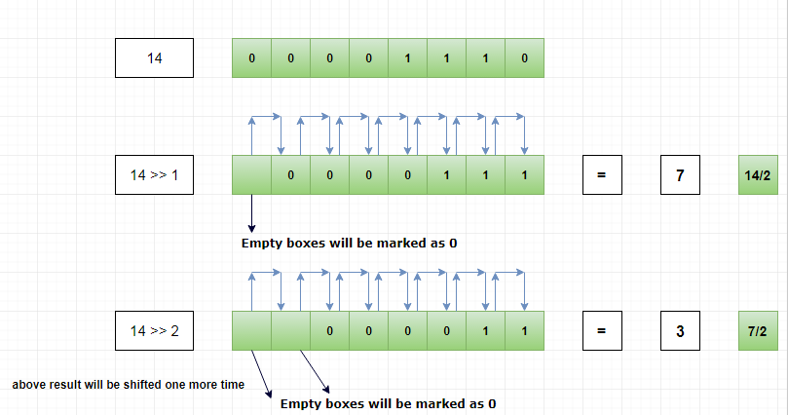
Let’s take a number 14.
Binary representation of 14 is 00001110 (for the sake of clarity let’s write it using 8 bit)
14 = (00001110) 2
Then 14 >> 1 will shift the binary sequence by 1 position to the right side.
Like,
Pictorial Explanation

Slide 21
13) Bitwise Left Shift and Assign: This operator is used to perform Bitwise left shift on the operands and then assigning result to the left operand.
Syntax:
x <<= y
a = 3
b = 5
# a = a << b
a <<= b
# Output
print(a)
Output :96

Slide 22
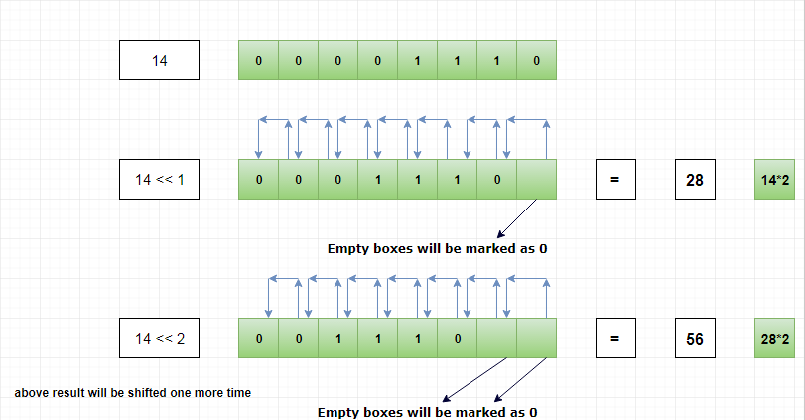
Bitwise Left shift operator is used to shift the binary sequence to the left side by specified position.
Example
Let’s take a number 14.
Binary representation of 14 is 00001110 (for the sake of clarity let’s write it using 8 bit)
14 = (00001110) 2
Then 14 << 1 will shift the binary sequence 1 position to the left side.
Like,

Slide 23
Python Comparison Operators
Comparison operators are used to compare two values:
Operator Name Example
== Equal x == y
!= Not equal x != y
> Greater than x > y
< Less than x < y
>= Greater than or equal to x >= y
<= Less than or equal to x <= y
```

Slide 24
Equal:
x = 5
y = 3
print(x == y)
# returns False because 5 is not equal to 3

Slide 25
Python Logical Operators
Logical operators are used to combine conditional statements:
Operator Description Example
and Returns True if both statements are true x < 5 and x < 10
or Returns True if one of the statements is true x < 5 or x < 4
not Reverse the result, returns False if the result is true not(x < 5 and x < 10)

Slide 26
# Python program to demonstrate
# logical and operator
a = 10
b = 10
c = -10
if a > 0 and b > 0:
print("The numbers are greater than 0")
if a > 0 and b > 0 and c > 0:
print("The numbers are greater than 0")
else:
print("Atleast one number is not greater than 0")

Slide 27
# Python program to demonstrate
# logical or operator
a = 10
b = -10
c = 0
if a > 0 or b > 0:
print("Either of the number is greater than 0")
else:
print("No number is greater than 0")
if b > 0 or c > 0:
print("Either of the number is greater than 0")
else:
print("No number is greater than 0")

Slide 28
# Python program to demonstrate
# logical not operator
a = 10
if not a:
print("This will return True")
if not (a%3 == 0 or a%5 == 0):
print("10 is not divisible by either 3 or 5")
else:
print("10 is divisible by either 3 or 5")

Slide 29
Python Identity Operators
Identity operators are used to compare the objects, not if they are equal, but if they are actually the same object, with the same memory location:
Operator Description Example
is Returns True if both variables are the same object x is y
is not Returns True if both variables are not the same object x is not y

Slide 30
Returns True if both variables are the same object
x = ["apple", "banana"]
y = ["apple", "banana"]
z = x
print(x is z)
# returns True because z is the same object as x
print(x is y)
# returns False because x is not the same object as y, even if they have the same content
print(x == y)
# to demonstrate the difference betweeen "is" and "==": this comparison returns True because x is equal to y

Slide 31
Returns True if both variables are not the same object
x = ["apple", "banana"]
y = ["apple", "banana"]
z = x
print(x is not z)
# returns False because z is the same object as x
print(x is not y)
# returns True because x is not the same object as y, even if they have the same content
print(x != y)
# to demonstrate the difference betweeen "is not" and "!=": this comparison returns False because x is equal to y

Slide 32
Python Membership Operators
Membership operators are used to test if a sequence is presented in an object:
Operator Description Example
in Returns True if a sequence with the specified value is present in the object x in y
not in Returns True if a sequence with the specified value is not present in the object x not in y

Slide 33
In Returns True if a sequence with the specified value is present in the object
x = ["apple", "banana"]
print("banana" in x)
# returns True because a sequence with the value "banana" is in the list

Slide 34
Not in
Returns True if a sequence with the specified value is not present in the object
x = ["apple", "banana"]
print("pineapple" not in x)
# returns True because a sequence with the value "pineapple" is not in the list

Slide 35
In Class Exercises :
Nidhi and Shubh are two students in the same grade. They have a total of 3 subjects in the school. After examination, they want to check whether their total marks are equal or not. So to help them write a program in python to take marks as input from two students. Print the overall score of both the students. Also, print "true" if they have an equal score or print "false" on the screen.
Hint: Take the input for marks and then use the “==“ operator to print the answer.
Varun is using a stopwatch to calculate his running speed. The stopwatch shows the time taken in seconds. He wants to convert it into minutes and seconds. Write a program to help him with this.
For input :
Enter the number of seconds: 125
Output :
>> 2 minutes and 5 seconds

Slide 36
In class exercise
Varun measures his running speed in kilometers per hour. For a better understanding, he wants to know his speed in meters per second as well. But he is facing a problem in calculating his speed in meters per second. Write a program for Varun where he can enter the speed in kilometers per hour and he can get the speed in meters per second.
Hint: divide the speed value by 3.6

Slide 37
Homework questions
Nidhi loves to travel to different countries. She is now in a country where the temperature is measured in Fahrenheit and she is not able to understand it in a better way. To help her in this situation, write a program to convert temperature from Fahrenheit to celsius.
Hint: (0°C × 9/5) + 32 = 32°F
In a school, the teacher asks students to tell whether the given number on the board is odd or even. Students were taking a lot of time to find out the answer. But Chirag realized that even and odd depends only on the last digit of the number. So write a program in python to take a number as input and then print only the last digit of the number. Also, discuss whether the given number is odd or even. If given number is even then print True on the screen and if the given number is odd then print False on the screen.
Hint: Take the number as input and then use “%10” to extract the last digit of the given number.

Slide 38
Homework questions
Shubham and his two more friends decided to share their chocolates equally among them. But they couldn't divide chocolates equally as they need a few more chocolates. Write a program to take three inputs for the number of chocolates and then print how many more chocolates they need to buy to divide it equally.

Slide 39
Thank you
End of session - 3

